Slide 1

Helping Seniors Enjoy Life at Home

Slide 2
Our Mission Statement
To preserve and protect the independence and dignity of our clients by providing an unsurpassed experience of care, service, and respect.

Slide 3
About Us
We are a community-based home health care organization providing important resources to our elderly and disabled clients and their families since 2004
We provide peace of mind and security to clients and their families knowing their loved ones have compassionate, reliable, and trusted home care when they need it
  Our professional team serves as a reliable resource for managed care programs by staffing any level of care quickly and efficiently

Slide 4
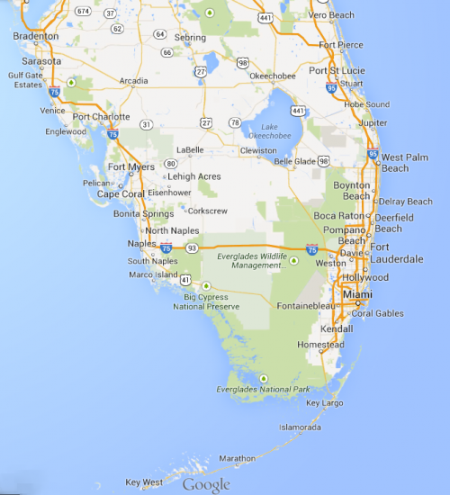
Our Service Area
Affinity Home Care is proud to link the resources of a leading home care system to homes in South Florida:
Palm Beach County
Broward County
Miami-Dade County

Slide 5
Our Services
Case Management
  Assisting both clients and managed care providers in arranging the finest care
Personal Care
Homemaker
Respite Care
Adult Companion
Attendant Care

Slide 6

Skilled Services
Affinity is now offering skilled home health care services, including:
  Skilled Nursing
  Physical Therapy
  Occupational Therapy
We are CHAP accredited

Slide 7
Our Specialties
Geriatric Care
Alzheimer’s/Dementia Care
Stroke Care
Parkinson’s Disease Care
Macular Degeneration Care
Multiple Sclerosis Care
Spinal Stenosis Care
Lou Gehrig’s/ALS Care
Huntington’s Disease Care
Hospice Support
Congestive Heart Failure Care
Brain and Spinal Cord Injury Care
Post Surgery Care
Custodial Care
https://www.affinityhomecare.com/specialties/

Slide 8
Statewide Medicaid Managed Care
We Work With
SMMC-LTC (Statewide Medicaid Managed Care)
- Sunshine Health
- Aetna
- Humana
- Simply Health Care
- United Healthcare
- Molina Healthcare
- Staywell Wellcare
- Florida Community Care
CCE (Community Care for the Elderly)

Slide 9
Our Team
To meet your needs, we’ve assembled an experienced staff of home health care specialists. We offer each of our clients:
Compassionate Caregiver – who delivers personalized, experienced home care
Care Coordinator – who coordinates care, and conducts free of charge follow-up visits to monitor care quality and provide ongoing support and education for family members at home
Patient Advocate – who will attend to all client needs and complaints, as well as act as a liaison to community resources
Experienced On-Call Coordinator – ready to respond to calls anytime, day or night (24 Hours).
  Other Administrative Staff

Slide 10
Our Staffing Coordinators
Large group of experienced coordinators who pre-screen caregivers, schedule and coordinate services
Languages spoken by staff coordinators
  English, Spanish, Portuguese, French, and others
24/7 On-Call Staff Coordinators ready to respond to calls
Able to start services within an hour of the initial service request

Slide 11
Our Compassionate Caregivers
Qualified, credentialed, and pre-screened CNAs, HHAs, RNs, and LPNs
Largest pool of available caregivers that can accommodate clients of different native languages
Our unique screening process enables us to select only the best caregivers
  In fact, less than 5% of interviewed candidates become AFFINITY caregivers

Slide 12
Quality of Services
Proven excellence based on our regular client satisfaction surveys
Client satisfaction is the only measure of success
Please review authentic client testimonials published on our website
https://www.affinityhomecare.com/testimonials/
Take a look at what some of our clients have to say about us…

Slide 13
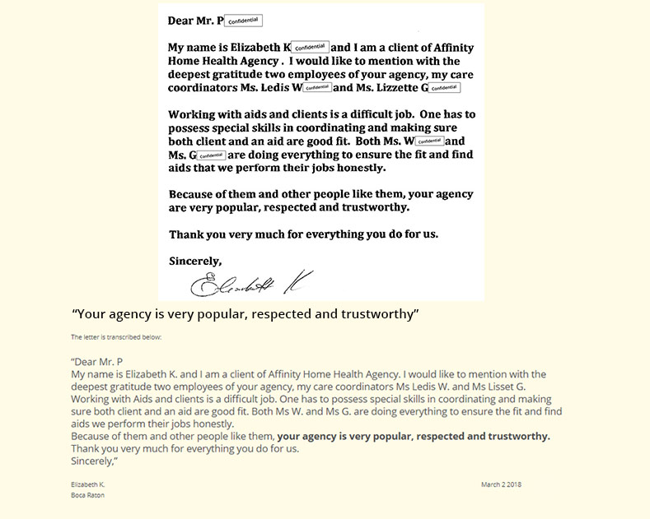

Slide 14
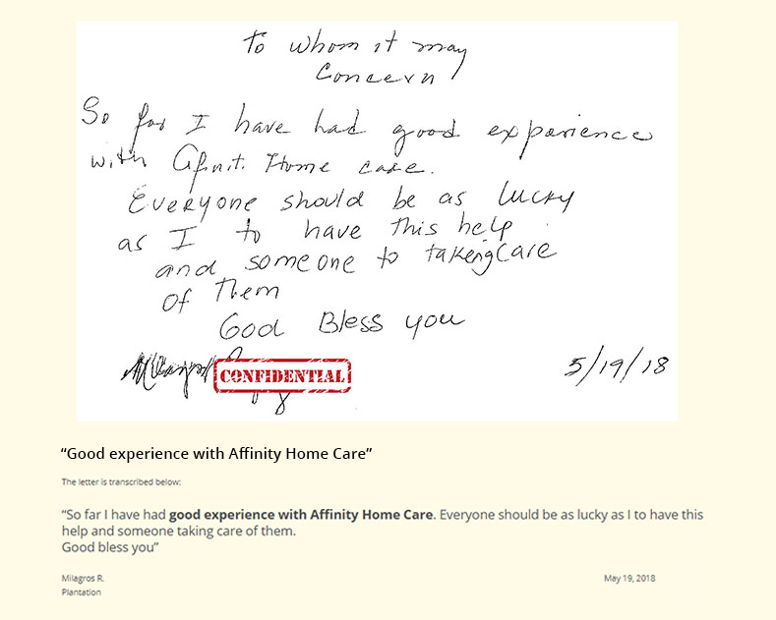

Slide 15
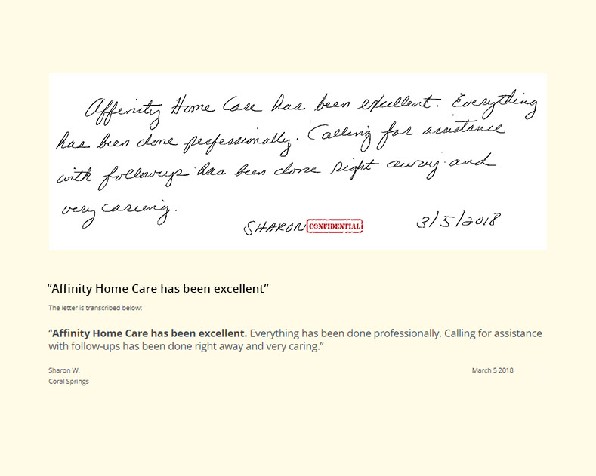

Slide 16
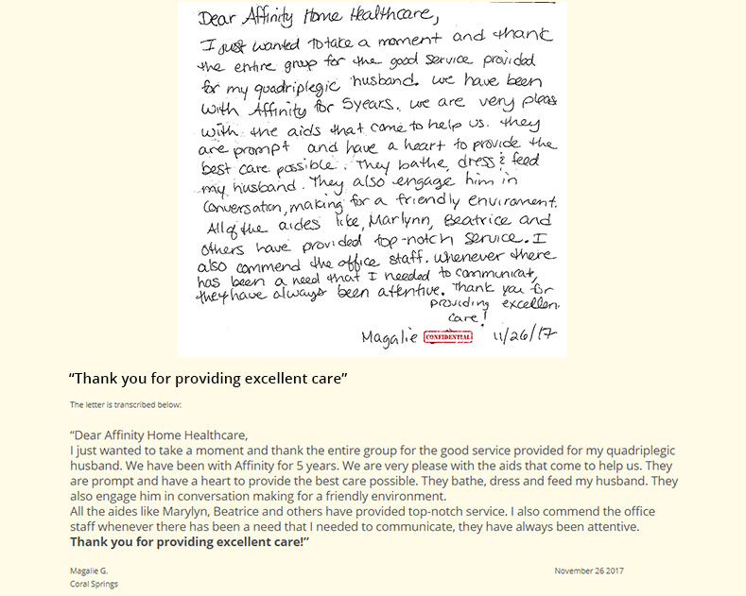

Slide 17
Affinity Home Care
Contact Us
Phone: 1-888-227-3205
Fax: 1-888-227-3170
Palm Beach County – Administrative Office
2328 10th Avenue N, Suite 106
Lake Worth, FL 33461
Broward County – Administrative Office
100 E Sample Rd., Suite 110
Pompano Beach, FL 33064
Miami-Dade County – Administrative Office
18425 NW 2nd Ave., Suite 401
Miami Gardens, FL 33169
info@AffinityHomeCare.com
www.AffinityHomeCare.com
License: 30211210, 30211273, 30211725

